Slide 1
Module 4
The Transport Layer

Slide 2
The Transport Service: Services Provided to the Upper Layers, Transport Service Primitives, An Example of Socket Programming. Elements of Transport Protocols: Addressing, Connection Establishment, Connection Release. The Internet Transport Protocols (UDP and TCP): Introduction to UDP, Introduction to TCP, The TCP Service Model, The TCP Protocol, The TCP Segment Header, TCP Connection Establishment, TCP Connection Release, and Sliding Window protocols.
Chapter 6: 6.1,6.2,6.4,6.5

Slide 3
Transport Service-Services Provided to the Upper Layers
Together with the network layer, the transport layer is the heart of the protocol hierarchy.
The network layer provides end-to-end packet delivery using datagrams or virtual circuits. The transport layer builds on the network layer to provide data transport from a process on a source machine to a process on a destination machine with a desired level of reliability that is independent of the physical networks currently in use.
It provides the abstractions that applications need to use the network.
The ultimate goal of the transport layer is to provide efficient, reliable, and cost-effective service to its users, normally processes in the application layer.
To achieve this goal, the transport layer makes use of the services provided by the network layer.
The hardware and/or software within the transport layer that does the work is called the transport entity.
The transport entity can be located in the operating system kernel, in a separate user process, in a library package bound into network applications, or on the network interface card.

Slide 4
Transport Service-Services Provided to the Upper Layers
The bottom four layers can be seen as the transport service provider, whereas the upper layer(s) are the transport service user.
To allow users to access the transport service, the transport layer must provide some operations to application programs, that is, a transport service interface. Each transport service has its own interface.
TPDU (Transport Protocol Data Unit) used for messages sent from transport entity to transport entity.
there are two types of network service, connection-oriented and connectionless, there are also two types of transport service.
The connection-oriented transport service is similar to the connection-oriented network service in many ways.
In both cases, connections have three phases: establishment, data transfer, and release.
Addressing and flow control are also similar in both layers.
Furthermore, the connectionless transport service is also very similar to the connectionless network service.

Slide 6
Transport Service Primitives
Packets are contained in frames .When a frame arrives, the data link layer processes the frame header and passes the contents of the frame payload field up to the network entity.
The network entity processes the packet header and passes the contents of the packet payload up to the transport entity.

Slide 7
To allow users to access the transport service, the transport layer must provide some operations to application programs, that is, a transport service interface. Each transport service has its own interface.
The transport service is similar to the network service, but there are also some important differences. The main difference is that the network service is intended to model the service offered by real networks and all. Real networks can lose packets, so the network service is generally unreliable.
The connection-oriented transport service, in contrast, is reliable. Of course, real networks are not error-free, but that is precisely the purpose of the transport layer—to provide a reliable service on top of an unreliable network.
A second difference between the network service and transport service is that the services are intended for. The network service is used only by the transport entities. Few users write their own transport entities, and thus few users or programs ever (meaning always/forever/still) see the bare network service

Slide 9
Berkeley Sockets
Sockets were first released as part of the Berkeley UNIX 4.2BSD software distribution in 1983. They quickly became popular. The primitives are now widely used for Internet programming on many operating system.
Socket Programming is a method to connect two nodes over a network to establish a means of communication between those two nodes. A node represents a computer or a physical device with an internet connection.
A socket is the endpoint used for connecting to a node. The signals required to implement the connection between two nodes are sent and received using the sockets on each node respectively.

Slide 10
Berkeley Sockets
the socket primitives used in Berkeley UNIX for TCP, These primitives are widely used for Internet programming

Slide 11
Server side
The SOCKET primitive creates a new end point and allocates table space for it within the transport entity.
A successful SOCKET call returns an ordinary file descriptor for use in succeeding calls.
Newly-created sockets do not have network addresses. These are assigned using the BIND primitive. Once a server has bound an address to a socket, remote clients can connect to it.
Next comes the LISTEN call, which allocates space to queue incoming calls for the case that several clients try to connect at the same time.

Slide 12
To block waiting for an incoming connection, the server executes an ACCEPT primitive. When a TPDU asking for a connection arrives, the transport entity creates a new socket with the same properties as the original one and returns a file descriptor for it.
ACCEPT returns a normal file descriptor, which can be used for reading and writing in the standard way, the same as for files.

Slide 13
Client side
a socket must first be created using the SOCKET primitive, but BIND is not required since the address used does not matter to the server.
The CONNECT primitive blocks the caller and actively starts the connection process. When it completes (i.e., when the appropriate TPDU is received from the server), the client process is unblocked and the connection is established.
Both sides can now use SEND and RECV to transmit and receive data over the full-duplex connection. The standard UNIX READ and WRITE system calls can also be used if none of the special options of SEND and RECV are required.
Connection release with sockets is symmetric. When both sides have executed a CLOSE primitive, the connection is released.

Slide 14
An example for socket programming(lab program)
The nodes are divided into two types, server node and client node.
The client node sends the connection signal and the server node receives the connection signal sent by the client node.
The connection between a server and client node is established using the socket over the transport layer of the internet.
After a connection has been established, the client and server nodes can share information between them using the read and write commands.
After sharing of information is done, the nodes terminate the connection.

Slide 15
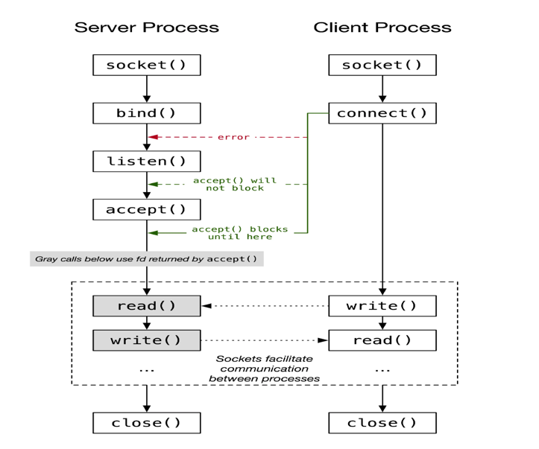

Slide 16
Elements of Transport Protocols
For another thing, the process of establishing a connection over the wire is simple: the other end is always there .
In the transport layer, initial connection establishment is more complicated.
difference between the data link layer and the transport layer is the potential existence of storage capacity in the subnet.
A final difference between the data link and transport layers is ,In the transport layer, the larger number of connections that must be managed

Slide 17
(a) Environment of the data link layer.
(b) Environment of the transport layer.

Slide 18
Addressing
  Data Link Layer: Each outgoing line connects to a specific router, so it doesn’t need to specify an address—the destination is implied.
  Transport Layer: Must explicitly specify the destination address, since multiple processes or applications may be communicating.
Connection Establishment
  Data Link Layer: Establishing a connection is simple—the other end is always there unless it has failed.
  Transport Layer: More complex, as it must handle initial handshakes, error checking, and possibly negotiate parameters before communication.
Storage and Delay in the Subnet
  Data Link Layer: Frames are either delivered or lost; they don’t get delayed unpredictably.
  Transport Layer: Packets can be stored temporarily in the network (due to adaptive routing or congestion) and delivered late, which can disrupt communication. Special protocols are needed to handle such cases.
Buffering and Flow Control
  Data Link Layer: Usually deals with a small number of lines, so fixed buffers per line are manageable.
  Transport Layer: Handles many simultaneous connections, so dynamic buffer allocation and more sophisticated flow control mechanisms are needed.

Slide 19
Elements of Transport Protocols
Addressing
Connection Establishment
Connection Release
Flow Control and Buffering
Multiplexing
Crash Recovery

Slide 20
1.Connection Establishment
Three-way handshake:This establishment protocol does not require both sides to begin sending with the same sequence number, so it can be used with synchronization methods other than the global clock method.
Three protocol scenarios for establishing a connection using a three-way handshake. CR denotes CONNECTION REQUEST.
  (a) Normal operation.
  (b) Old duplicate CONNECTION REQUEST appearing out of nowhere.
  (c) Duplicate CONNECTION REQUEST and duplicate ACK.

Slide 22
Case1:Host 1 chooses a sequence number, x, and sends a CONNECTION REQUEST TPDU containing it to host 2. Host 2 replies with an ACK TPDU acknowledging x and announcing its own initial sequence number, y. Finally, host 1 acknowledges host 2's choice of an initial sequence number in the first data TPDU that it sends.
Case 2:first TPDU is a delayed duplicate CONNECTION REQUEST from an old connection. This TPDU arrives at host 2 without host 1's knowledge. Host 2 reacts to this TPDU by sending host 1 an ACK TPDU, in effect asking for verification that host 1 was indeed trying to set up a new connection. When host 1 rejects host 2's attempt to establish a connection, host 2 realizes that it was tricked by a delayed duplicate and abandons the connection. In this way, a delayed duplicate does no damage.
Case 3:host 2 gets a delayed CONNECTION REQUEST and replies to it. At this point it is crucial to realize that host 2 has proposed using y as the initial sequence number for host 2 to host 1 traffic, knowing full well that no TPDUs containing sequence number y or acknowledgements to y are still in existence. When the second delayed TPDU arrives at host 2, the fact that z has been acknowledged rather than y tells host 2 that this, too, is an old duplicate.

Slide 23
2.Connection Release
There are two styles of terminating a connection: asymmetric release and symmetric release.
Asymmetric release is the way the telephone system works: when one party hangs up, the connection is broken.
Symmetric release treats the connection as two separate unidirectional connections and requires each one to be released separately.
EX: After the connection is established, host 1 sends a TPDU that arrives properly at host 2. Then host 1 sends another TPDU. Unfortunately, host 2 issues a DISCONNECT before the second TPDU arrives. The result is that the connection is released and data are lost.

Slide 24
Four protocol scenarios for releasing a connection. (a) Normal case of three-way handshake. (b) Final ACK lost. (c) Response lost. (d) Response lost and subsequent DRs lost.

Slide 25
Case 1:normal case in which one of the users sends a DR (DISCONNECTION REQUEST) TPDU to initiate the connection release. When it arrives, the recipient sends back a DR TPDU, too, and starts a timer, just in case its DR is lost. When this DR arrives, the original sender sends back an ACK TPDU and releases the connection. Finally, when the ACK TPDU arrives, the receiver also releases the connection. Releasing a connection means that the transport entity removes the information about the connection from its table of currently open connections and signals the connection's owner
Case 2:Now consider the case of the second DR being lost. The user initiating the disconnection will not receive the expected response, will time out, and will start all over again. If the final ACK TPDU is lost, the situation is saved by the timer. When the timer expires, the connection is released anyway.
Case 3: assuming that the second time no TPDUs are lost and all TPDUs are delivered correctly and on time.
Case 4: assuming that all the repeated attempts to retransmit the DR also fail due to lost TPDUs. After N retries, the sender just gives up and releases the connection. Meanwhile, the receiver times out and also exits.

Slide 26
3.Addressing
When an application process (such as a user program) wants to communicate with a remote application, it must specify which process on the remote system to connect to. This applies to both connection-oriented and connectionless transport services — each message or connection must know where it’s going.
Transport Addresses (TSAPs):
To handle this, transport protocols define transport addresses, also called Transport Service Access Points (TSAPs).
Each process that wishes to receive communication listens on a specific TSAP.
In the Internet, these are known as ports.
In ATM networks, they are called AAL-SAPs. Thus, “TSAP” is a general term for these transport-level endpoints.
The corresponding concept in the network layer is the Network Service Access Point (NSAP) — for example, IP addresses serve as NSAPs.
  IP address → identifies which device (host) on the network.
  Port number → identifies which process or service on that device.
  TSAP = IP address + Port number → identifies exactly where the data should go

Slide 27
1. A time of day server process on host 2 attaches itself to TSAP 1522 to wait for an incoming call. A call such as our LISTEN might be used,
2. An application process on host 1 wants to find out the time-of-day, so it issues a CONNECT request specifying TSAP 1208 as the source and TSAP 1522 as the destination. This action ultimately results in a transport connection being established between the application process on host 1 and server 1 on host 2.
3. The application process then sends over a request for the time.
4. The time server process responds with the current time.
5. The transport connection is then released.

Slide 28
4.Flow Control and Buffering
After establishing a connection, the next important task is managing the data flow between the sender and receiver. This involves flow control and buffering — ensuring that data is sent at a rate that the receiver can handle without being overwhelmed.

Slide 29
Flow Control Concept
Flow control prevents a fast sender from overrunning a slow receiver.
Both the data link layer and transport layer use mechanisms like sliding window protocols for this purpose.
However, there’s a major difference:
  In the data link layer, routers have few lines to manage.
  In the transport layer, a host may have many simultaneous connections, making it impractical to assign fixed buffers for each connection.

Slide 30
Buffering in the Transport Layer
(a) Data Link Layer Buffering
In data link protocols both sender and receiver routers keep a fixed number of buffers per line.
(b) Transport Layer Buffering
The sender must buffer all outgoing Transport Protocol Data Units (TPDUs) until they are acknowledged, in case they need retransmission.
The receiver may use:
  Dedicated buffers for each connection, or
  A shared buffer pool for all connections.
If no buffer is available when a TPDU arrives, it may be discarded. The sender will simply retransmit it later, since it already keeps a copy.

Slide 31
Sender vs Receiver Buffering
For low-bandwidth, bursty traffic (like interactive terminal sessions):
→ Better to buffer at the sender.
→ Buffers are allocated dynamically as needed.
For high-bandwidth, steady traffic (like file transfers):
→ Better to buffer at the receiver.
→ The receiver dedicates a full window of buffers to keep data flowing smoothly.
With an unreliable network service, the sender must buffer all sent TPDUs until acknowledged.
With a reliable network service, buffering strategy can vary:
  If the sender knows the receiver always has space, it can avoid keeping copies.
  But if the receiver may run out of buffers, the sender must still buffer, since a network-level acknowledgment only means arrival, not acceptance by the receiver.

Slide 32
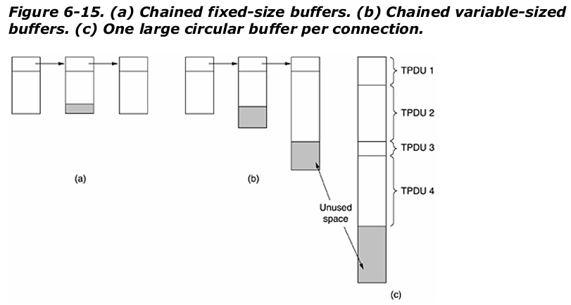
Buffer Size Management
The question of how large buffers should be depends on TPDU sizes and traffic types.
Types of Buffering Approaches:
Fixed-size buffers:
  One TPDU per buffer (good for uniform sizes).
  Wastes space when TPDUs are small.
  Needs multiple buffers for large TPDUs.
Variable-size buffers:
  Better memory efficiency.
  More complex buffer management.
Circular buffer per connection:
  Uses memory efficiently for busy connections.
  Wasteful if some connections are idle.

Slide 33
5.Multiplexing
Multiplexing means sharing one connection or link among multiple conversations.
It helps different processes or applications use the same network interface efficiently.
Upward Multiplexing:
When a host has only one network address, multiple transport connections must use that same address.
Incoming packets are then separated and delivered to the correct process.
Downward Multiplexing:
Sometimes a single network connection cannot provide enough bandwidth.
To increase capacity, multiple network connections are opened and used together.
In downward multiplexing, data is split across multiple connections (e.g., round-robin sending).
This increases the effective bandwidth.
Example:
An ISDN line offers two 64 kbps channels.
Using both channels simultaneously gives the user 128 kbps total bandwidth through downward multiplexing.

Slide 34
6.Crash Recovery
•When data transfers take a long time (like downloading big files), sometimes a host (computer) or a router (network device) might crash. The system must then figure out how to recover the connection without starting everything from the beginning.
Router or network crashes are easier to handle:
  If routers or parts of the network fail, packets may get lost.
  The transport layer (like TCP) in the hosts already knows how to handle lost packets by retransmitting them, so this recovery is manageable.
Host crashes are harder to handle:
  If a host (like a client or server) crashes, the connection state (like sequence numbers, buffers, etc.) is lost.
  When the host comes back (reboots), it no longer remembers the old connection.
  This causes problems for long-lived connections, because the other side (the peer) may still think the connection is active.
Desirable behavior:
  Ideally, after a server crash and quick reboot, clients should be able to resume their session without having to start over completely.
  This requires special mechanisms for connection recovery and state synchronization after a crash.

Slide 35
The Internet Transport Protocols
The Internet has two main protocols in the transport layer, a connectionless protocol and a connection- oriented one. The protocols complement each other.
The connectionless protocol is UDP. It does almost nothing beyond sending packets between applications, letting applications build their own protocols on top as needed.
The connection-oriented protocol is TCP. It does almost everything. It makes connections and adds reliability with retransmissions, along with flow control and congestion control, all on behalf of the applications that use it.

Slide 36
UDP
The Internet protocol suite supports a connectionless transport protocol called UDP(User Datagram Protocol).
UDP provides a way for applications to send encapsulated IPdatagrams without having to establish a connection.
UDP transmits segments consisting of an 8-byte header followed by the payload.
The two ports serve to identify the end-points within the source and destination machines.
When a UDP packet arrives, its payload is handed to the process attached to the destination port. With them, it delivers the embedded segment to the correct application.

Slide 37
Source port, destination port: Identifies the end points within the source and destination machines.
UDP length: Includes 8-byte header and the data
UDP checksum: Includes the UDP header, the UDP data padded out to an even number of bytes if need be. It is an optional field

Slide 38
REMOTE PROCEDURE CALL
In a certain sense, sending a message to a remote host and getting a reply back is like making a function call in a programming language. This is to arrange request-reply interactions on networks to be cast in the form of procedure calls.
RPC is used to call remote programs using the procedural call.
When a process on machine 1 calls a procedure on machine 2, the calling process on 1 is suspended and execution of the called procedure takes place on 2.
Information can be transported from the caller to the callee in the parameters and can come back in the procedure result. No message passing is visible to the application programmer. This technique is known as RPC (Remote Procedure Call) and has become the basis for many networking applications.

Slide 39
Traditionally, the calling procedure is known as the client and the called procedure is known as the server.
In the simplest form, to call a remote procedure, the client program must be bound with a small library procedure, called the client stub, that represents the server procedure in the client’s address space.
Similarly, the server is bound with a procedure called the server stub. These procedures hide the fact that the procedure call from the client to the server is not local.

Slide 40
Step 1 is the client calling the client stub. This call is a local procedure call, with the parameters pushed onto the stack in the normal way.
Step 2 is the client stub packing the parameters into a message and making a system call to send the message. Packing the parameters is called marshaling.
Step 3 is the operating system sending the message from the client machine to the server machine.
Step 4 is the operating system passing the incoming packet to the server stub.
Step 5 is the server stub calling the server procedure with the unmarshaled parameters. The reply traces the same path in the other direction.

Slide 41
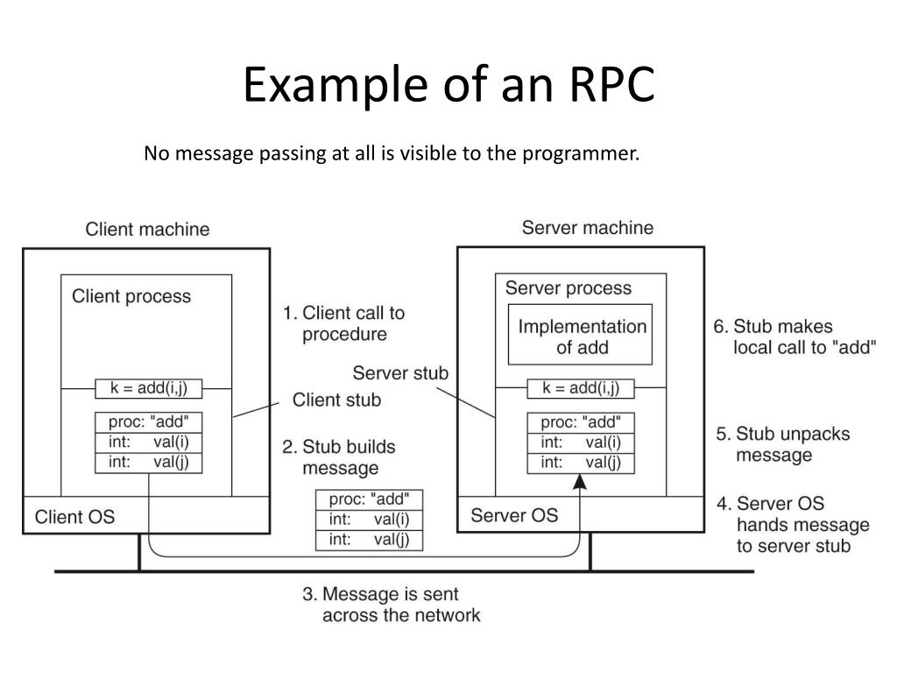

Slide 42
UDP Applications
UDP does not provide error control; it provides an unreliable service.
UDP is suitable for a process that requires simple request-response communication with little concern for flow and error control
UDP is suitable for a process with internal flow- and error-control mechanisms.
UDP is a suitable transport protocol for multicasting. Multicasting capability is embedded in the UDP software
UDP is used for management processes such as SNMP.(simple network management protocol)
UDP is used for some route updating protocols such as Routing Information Protocol(RIP)
UDP is normally used for interactive real-time applications that cannot tolerate uneven delay between sections of a received message

Slide 43
TCP
It was specifically designed to provide a reliable end-to end byte stream over an unreliable network.
It was designed to adapt dynamically to properties of the inter network and to be robust in the face of many kinds of failures.
Each machine supporting TCP has a TCP transport entity, which accepts user data streams from local processes, breaks them up into pieces not exceeding 64kbytes and sends each piece as a separate IP datagram.
When these datagrams arrive at a machine, they are given to TCP entity, which reconstructs the original byte streams.
It is up to TCP to time out and retransmits them as needed, also to reassemble datagrams into messages in proper sequence.

Slide 44
Characteristics
connection oriented: 3-way handshaking
full duplex: bidirectional, Full duplex means that traffic can go in both directions at the same time.
point-point: Point-to-point means that each connection has exactly two endpoints.
A TCP connection is a byte stream, not a message stream.
piggyback: data+ack, go back and selective repeat
error control: Checksums (detect errors)
flow control: TCP uses Sliding Window Protocol
congestion control: Slow Start, Congestion Avoidance
Selective acknowledgements
repurposing of header fields for quality of service
improved retransmission timers
explicit congestion notification.

Slide 45
The TCP Service Model
TCP service is obtained by having both the sender and receiver create end points called SOCKETS
Each socket has a socket number(address)consisting of the IP address of the host, called a “PORT” ( = TSAP )
To obtain TCP service a connection must be explicitly established between a socket on the sending machine and a socket on the receiving machine
All TCP connections are full duplex and point to point i.e., multicasting or broadcasting is not supported.
A TCP connection is a byte stream, not a message stream i.e., the data is delivered as chunks

Slide 46
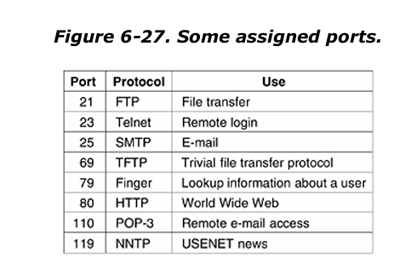
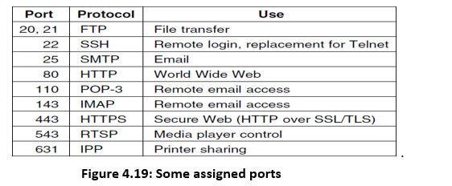

Slide 48
The TCP Protocol
1. TCP assigns a unique 32-bit sequence number to every byte
  TCP is designed so that each byte of data sent in a connection has its own sequence number.
  This helps in ordering, reliability, and detecting lost or duplicate data.
2. TCP data is transmitted in variable-size segments
  Data is sent as segments, each containing:
  A 20-byte header (minimum)
  Optional fields
  A block of data
  TCP decides how much data to put into each segment (merge or split depending on size).
3. Segment size is limited by IP payload and MTU(Maximum Transmission Unit)
  Two limits determine how big a TCP segment can be:
  IP payload limit → 65,515 bytes
  MTU is the maximum data size a network link can carry in one frame -usually 1500 bytes on Ethernet, So in practice, the MTU (1500 bytes) is the main limit.
  If TCP tries to send a segment larger than the MTU:
  The IP layer must fragment it into many smaller pieces
  This is inefficient and increases the chance of packet loss

Slide 49
4. TCP uses the sliding window protocol for reliable delivery
  TCP sends segments and starts a timer.
  If an acknowledgement (ACK) arrives before timeout → good.
  If timeout happens → TCP retransmits the segment.
5. TCP handles out-of-order, delayed, and retransmitted segments
  Data may arrive:
  Out of order
  Late
  Repeated (due to retransmission)
  TCP must track which bytes are received correctly and reorder them based on sequence numbers.
6. TCP includes many optimized algorithms to improve performance
  Over time, TCP has been enhanced with techniques for:
  Faster recovery
  Efficient retransmission
  Better congestion handling
  These help TCP remain reliable even on problematic networks.

Slide 50
The TCP Segment Header
Every segment begins with a fixed-format, 20-byte header.
The fixed header may be followed by header options.
After the options, if any, up to 65,535 - 20 - 20 = 65,495 data bytes may follow, where the first 20 refer to the IP header and the second to the TCP header.
Segments without any data are legal and are commonly used for acknowledgements and control messages.

Slide 52
Source Port, Destination Port : Identify local end points of the connections
Sequence number: Specifies the sequence number of the segment
Acknowledgement Number: Specifies the next byte expected.
TCP header length: Tells how many 32-bit words are contained in TCP header
URG: It is set to 1 if URGENT pointer is in use, which indicates start of urgent data.
ACK: It is set to 1 to indicate that the acknowledgement number is valid.
PSH: Indicates pushed data
RST: It is used to reset a connection that has become confused due to reject an invalid segment
FIN: Used to release a connection.
SYN: Used to establish connections.
Window size: field tells how many bytes may be sent starting at the byte acknowledged.
Checksum: is also provided for extra reliability.
Options: field provides a way to add extra facilities

Slide 53
TCP Connection Establishment
To establish a connection, one side, the server, passively waits for an incoming connection by executing the LISTEN and ACCEPT primitives, either specifying a specific source or nobody in particular.
The other side, say, the client, executes a CONNECT primitive, specifying the IP address and port to which it wants to connect
The CONNECT primitive sends a TCP segment with the SYN bit on and ACK bit off and waits for a response.
The connection establishment in TCP is called three-way handshaking which is explained before in Elements of Transport Layer. An application program, called the client, wants to make a connection with another application program, called the server, using TCP as the transport-layer protocol. The process starts with the server. The server program tells its TCP that it is ready to accept a connection. This request is called a passive open. Although the server TCP is ready to accept a connection from any machine in the world, it cannot make the connection itself. The client program issues a request for an active open. A client that wishes to connect to an open server tells its TCP to connect to a particular server. TCP can now start the three-way handshaking process.

Slide 54
a) TCP Connection establishment in the normal case b) Call Collision

Slide 55
TCP Connection Release
Although TCP connections are full duplex, to understand how connections are released it is best to think of them as a pair of simplex connections.
Each simplex connection is released independently of its sibling. To release a connection, either party can send a TCP segment with the FIN bit set, which means that it has no more data to transmit.
When the FIN is acknowledged, that direction is shut down for new data. Data may continue to flow indefinitely in the other direction, however.
When both directions have been shut down, the connection is released.
Normally, four TCP segments are needed to release a connection, one FIN and one ACK for each direction. However, it is possible for the first ACK and the second FIN to be contained in the same segment, reducing the total count to three.

Slide 56
Sliding Window Protocol
This protocol allows sharing multiple data frames from the sender before receiving any acknowledgment from the receiver side.
The data frames shared in the channel are defined by the window size mentioned in the network model, which defines the maximum number of frames that can be transmitted at a time from the sender to the receiver side before expecting any acknowledgment.
Each of the frames in the network model is assigned a sequence number to increase the transmission efficiency.
The data frames shared from the sender to the receiver side are enclosed within a virtual sliding window, which represents that these are awaiting acknowledgment from the receiver side. Requirements are:
Sender and the receiver side
Window Size
The total data frames to be transmitted
Proper sequencing of the frames

Slide 57
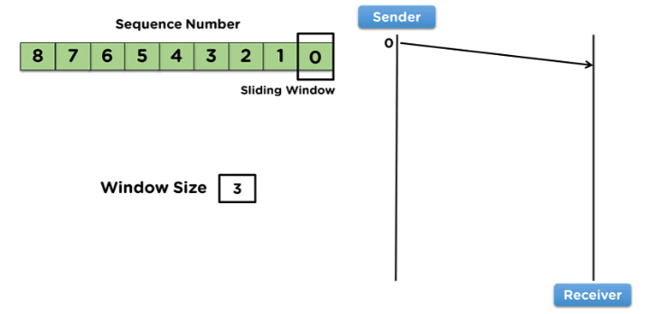

Slide 58
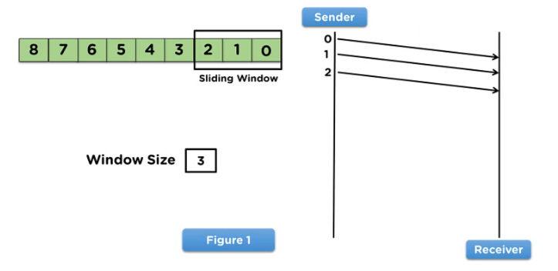
Steps for the Sender Side
To begin with, the sender side will share data frames with the receiver side per the window size assigned to the model.
The sliding window will appear on the frames transmitted over to the receiver side.
Then the sender will wait for an acknowledgment from the receiver side for the shared frames, as mentioned in figure1.

Slide 59
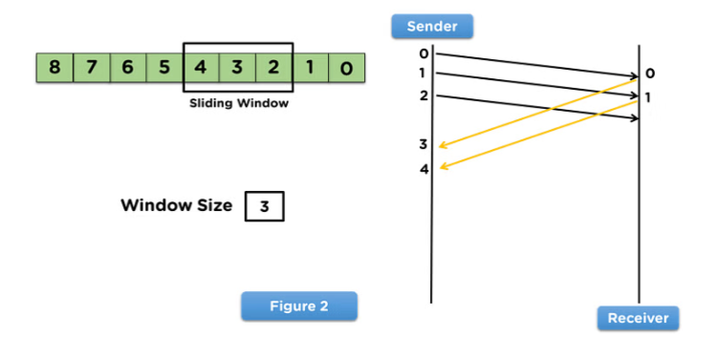
Steps for the Receiver Side
On receiving the data frames from the sender side, the receiver will use the frames in the network model.
After the receiver uses the frame, it will transmit the acknowledgement to the sender side for that data frame.
Then, the receiver side will receive the next data frame from the sender side, as mentioned in figure2.

Slide 60
Advantages and Disadvantages of Sliding Window Protocol
Advantages
Higher efficiency: The sender can transmit multiple frames before waiting for an acknowledgment, which increases channel utilization.
Reduced waiting time: Since multiple frames are sent consecutively, the overall time delay is lower compared to stop-and-wait systems.
Supports full-duplex communication: Both sender and receiver can simultaneously send and receive frames, improving throughput.
Frame management: Requires frame sorting and sequencing at the receiver, which improves reliability and orderly processing.
Disadvantages
Inefficiency during lost acknowledgments: If the sender does not receive an acknowledgment, it may retransmit many frames, reducing performance.
Bandwidth wastage: Loss of any frame results in retransmission of multiple frames, leading to bandwidth wastage.
Higher complexity: Maintaining sequence numbers, buffers, and sorting mechanisms increases system complexity compared to simple protocols.

Slide 61
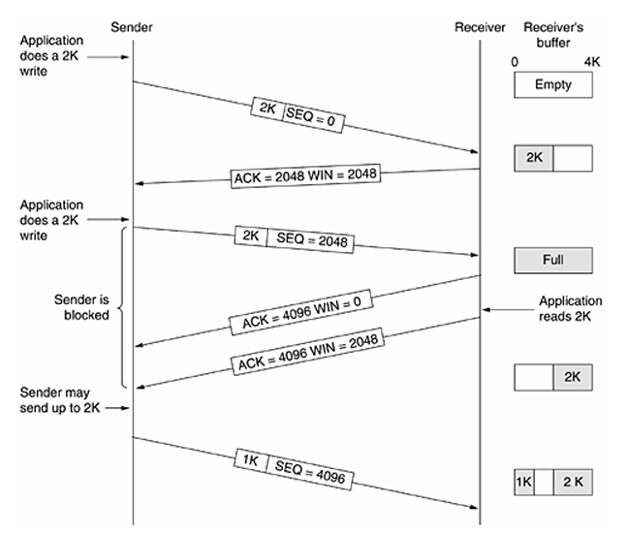
Transmission policy
(Window Management)
Receiver has a 4096-byte buffer, so TCP uses a sliding window to avoid overflow.
Sender first sends 2048 bytes; receiver ACKs and advertises remaining 2048 bytes.
Sender sends the next 2048 bytes; buffer becomes full and receiver advertises a window of 0.
When window = 0, the sender must stop sending more data.
Receiver frees space when the application reads data, so later it can advertise a larger window again.
To avoid deadlock when window = 0, sender can send urgent data or a 1-byte probe to make receiver announce updated window.
TCP allows both sender and receiver to delay sending data/ACKs to create larger, more efficient segments.

Slide 62
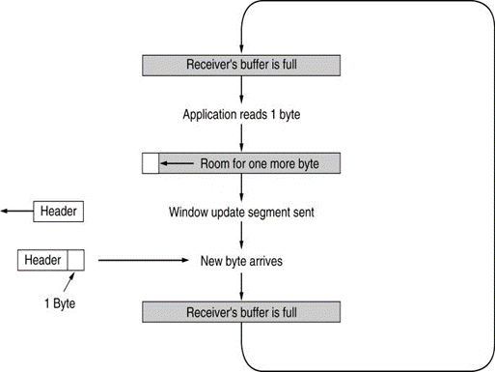
When the receiver’s buffer becomes full, it advertises a window size of 0, so the sender must stop sending data.
The receiver’s application reads only 1 byte, so the receiver now has just 1 byte of free space and advertises a 1-byte window.
The sender sends a packet carrying only 1 byte of data with full TCP/IP headers, which is highly inefficient.
After receiving that 1 byte, the receiver’s buffer becomes full again, and the same cycle repeats, which is exactly what the figure shows.
Interactive applications may send many tiny packets, causing bandwidth wastage.
TCP may delay ACKs for about 500 ms to combine ACK/window updates with outgoing data.
Nagle’s algorithm sends one byte immediately and buffers the rest until the previous data is acknowledged to avoid tiny packets.
Silly Window Syndrome is prevented by making the receiver advertise a larger window (MSS or half buffer) instead of 1 byte, improving efficiency.

Slide 63
TCP CONGESTION CONTROL
Congestion occurs in a network when the amount of data sent is more than what the network can handle, causing packets to be delayed or lost.
TCP deals with congestion mainly by slowing down the data transmission rate, because reducing speed is the only way to avoid overwhelming the routers.
TCP follows the idea similar to “conservation of packets,” meaning the sender should inject a new packet into the network only after an old packet has successfully left, helping avoid overload.
Timeouts are used as a signal of congestion. Since modern links rarely lose packets due to noise, TCP assumes most timeouts indicate congestion in the network.
Each TCP sender maintains two limits: one from the receiver (receiver window) and one based on network conditions (congestion window). The actual amount sent is the minimum of these two windows

Slide 64
•A connection begins with the congestion window set to one MSS (maximum segment size). If ACKs arrive successfully, the congestion window grows exponentially by adding one MSS for each ACK—this is the slow start phase.
The sender keeps doubling its congestion window as long as packets are acknowledged, until either a timeout happens or it reaches the receiver’s allowed window.
When a timeout occurs, TCP assumes the network is congested, cuts the congestion window to one MSS, and reduces a threshold value to half of the previous congestion window.
After a timeout, TCP again increases the congestion window using slow start until it reaches the threshold; beyond the threshold, it increases the window linearly, one MSS per round, allowing smooth growth without overloading the network again.

Slide 65
In fig (a): We see a thick pipe leading to a small- capacity receiver. As long as the sender does not send more water than the bucket can contain, no water will be lost.
In fig (b): The limiting factor is not the bucket capacity, but the internal carrying capacity of the n/w. if too much water comes in too fast, it will backup and some will be lost.

